Slide 1

North South University
Department of Electrical & Computer Engineering
Project Proposal
Junior Design – CSE299
Project title: Malerial Cell Classification using deep learning
Submitted to : Dr. Mohammad Monirujjaman Khan
Submitted by : Reajus Salahin Shyon – 1822187042
Hasibul Hossain -1821534042
Fahim Faisal Ratul - 1712697642
Submitted Date : 24 November, 2021

Slide 2
Background
Malaria is a fatal form of disease caused by parasites transmitted by the bites of mosquitoes.
More common in tropical regions on the world average.
Malaria is a major threat to global health.
Great importance in terms of correct diagnosis and the patient's early recovery process.
In particular, deep learning, which has high success in classifying large amounts of data is utilized.

Slide 3
Problem Statement
To detect malaria the doctor has to see a smear image of the blood whether his blood is affected by malaria or not.
If it is affected then he is malaria positive and if not, he is negative.
But If it remains undetected then it can spread and people can die.
With the help of deep learning, our model can detect the malaria virus from the blood smear image very fine.
Our model can analyze and identify which blood report is affected and which is not.

Slide 4
Objective
To solve the problem using deep learning.
The most popular deep learning algorithms are:
1.Convolutional Neural Network (CNN)
2.Recurrent Neural Networks (RNNs)
3.Long Short-Term Memory Networks (LSTMs)

Slide 5
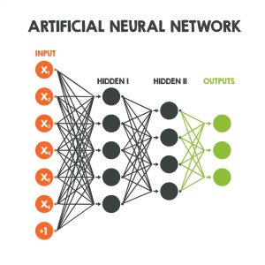
Algorithm Description
CNN:
A Convolutional Neural Network (CNN) is a type of neural network that specializes in processing data with a grid-like architecture, such as an image. A binary representation of visual data is a digital image.
A typical neural network will have an input layer, hidden
layers, and an output layer. CNNs are inspired by the
architecture of the brain.

Slide 6
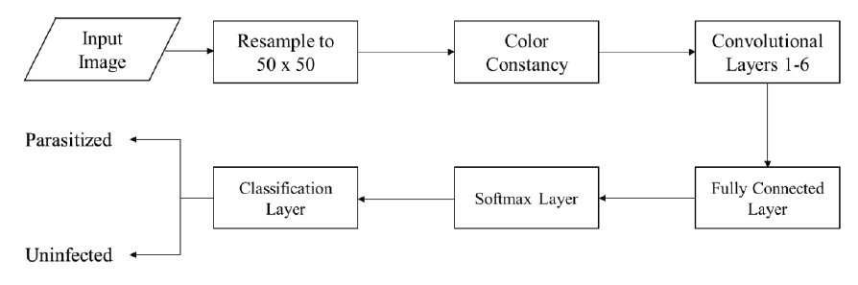
CNN architecture

Slide 7
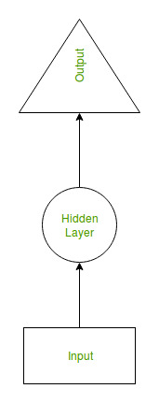
Algorithm Description
RNNs:
RNN are a type of Neural Network where the output from previous step are fed as input to the current step.
RNN have a “memory” which remembers all information about
what has been calculated.
It uses the same parameters for each input as it performs the same
task on all the inputs or hidden layers to produce the output.

Slide 8
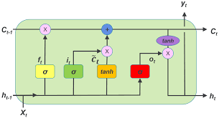
Algorithm Description
LSTM:
LSTM) is an artificial recurrent neural network (RNN) architecture used in the field of deep learning.
LSTM networks are well-suited to classifying,
processing and making predictions based on time
series data.

Slide 9
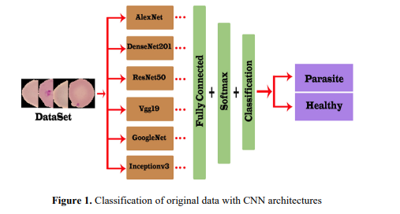
Diagram

Slide 10
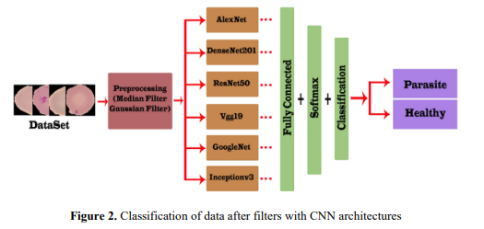
Diagram

Slide 11
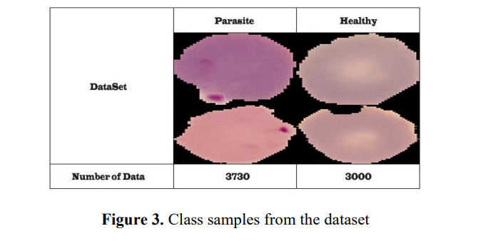
Diagram

Slide 12
Result and Analysis
Our model provided 96 percent accuracy and 97 percent validation accuracy in the 10th epoch.
The validation accuracy began at 95% and ended at 0.9716 after the tenth epoch.
VGG19 has a train accuracy of 96 percent and a validation accuracy of 97 percent.
It has a train loss of 10% and a validation loss of 9%.

Slide 13
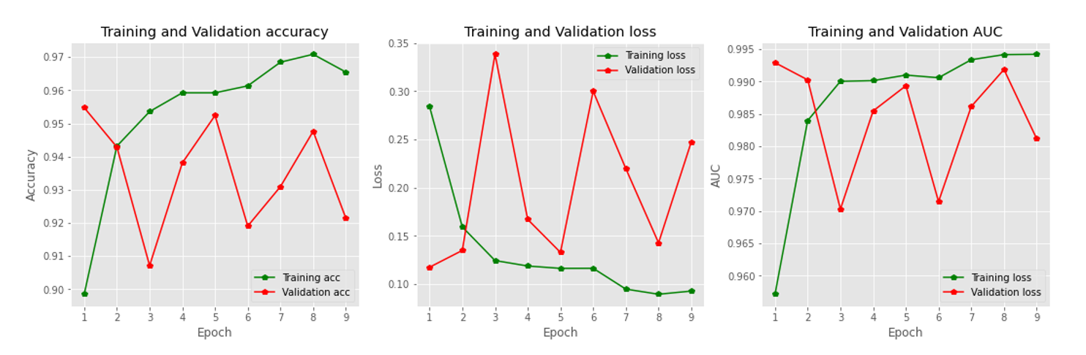
Model Accuracy and Model loss

Slide 14
Dataset
In this paper, data are obtained from Kaggle dataset [19].
There are 2 types of data classes.
The data set contains 3730 parasitic data and 3000 healthy data.

Slide 15
Conclusion
In this paper, malaria images were classified using CNN methods, which are very popular in recent years.
The application was implemented in Matlab environment and using AlexNet, ResNet50, DenseNet201, Vgg19, GoogleNet and Inceptionv3 models.
Working with Gaussian filtered data increased our accuracy when classifying.
Once malaria data is classified, it will be easier to draw conclusions and diagnose the disease by specialists.

Slide 16
Thank you

